Slide 1

Specialization
Dotnet 6.0 with Architecture
C# 9.0, WPF 4.5 .2 with Blend
ASP.Net Core 5.0 , Micro services
WCF 4.5.1, Web API, WF 4.5.1
Advanced Python, Django, Flask
Python network Automation, ML & AI
Micro-frontend ,MEAN & MERN stack
UML 2 and OOAD, DDD
HTML 5, CSS 3, SASS, Bootstrap
65 .Net Design Patterns
ES 6, Jquery 3.x,D3.js,YAML,JSON
Aurelia, Post CSS, Lost Grid, AMD
Typescript, Angular 15
Vue js, Oracle Jet, Open UI 5
React 18.0 & Redux, React Native
Apollo client, GraphQL
Ext JS 6, Backbone ,Kendo UI
Node js, Mongo DB & Restify
Mocha, Jasmine,Protractor, Karma
Docker, Webpack, Grunt, Gulp,
VUE JS 3.0 with VueX & Vite
Dr. D.S.R.Murthy M.Tech (IT)
Software Architect & Corporate Trainer
Experience : 31 years

Slide 2
VUE JS 3.0 - Topics
Intro to Vue.js with version comparison
Virtual DOM
Data Binding (v-bind,v-model,v-text)
Event Handling
Computed Properties
Templates and Directives
Watchers and Filters (Pipes)
Routing with Guards (Vue-router) and lazy routing
debugging with vue-dev Tools
Declarative Rendering
Conditionals and Loops
Handling User Input with Form binding
Composing with Components
D.S.R.Murthy

Slide 3
VUE JS - Topics
The Vue Instance
Template Syntax
Computed Properties vs Watchers vs methods
Class and Style Bindings
Conditional Rendering
List Rendering
Event Handling and custom events
Form Input Bindings
Components in vue
Component Registration
Props and proptypes for validation
Slots and Named slots
Dynamic & Async Components
Enter/Leave & List Transitions
State Transitions
Reusability & Composition
Mixins
Custom Directives
Render Functions & JSX
Plugins
Filters
Portals
Fragments
Global Mounting
Suspense
D.S.R.Murthy

Slide 4
VUE JS - Topics
Tooling - vite
Single File Components
Unit Testing
TypeScript Support
Production Deployment
Routing
State Management with Vuex
Global API
Composition API
Security
build and deployment
D.S.R.Murthy

Slide 5
What is Vue JS?
- Vue.js 3.0 is the latest version of the Vue.js framework (September 2020 with several improvements ,changes and performance compared to the previous version, Vue.js 2.0.
- It has the best practices taken from Angular and React.
- Configurable with Vite for superfast build system.
- Enables to use Vuetify plugin for vue-components
D.S.R.Murthy

Slide 6
VUE JS
D.S.R.Murthy

Slide 7
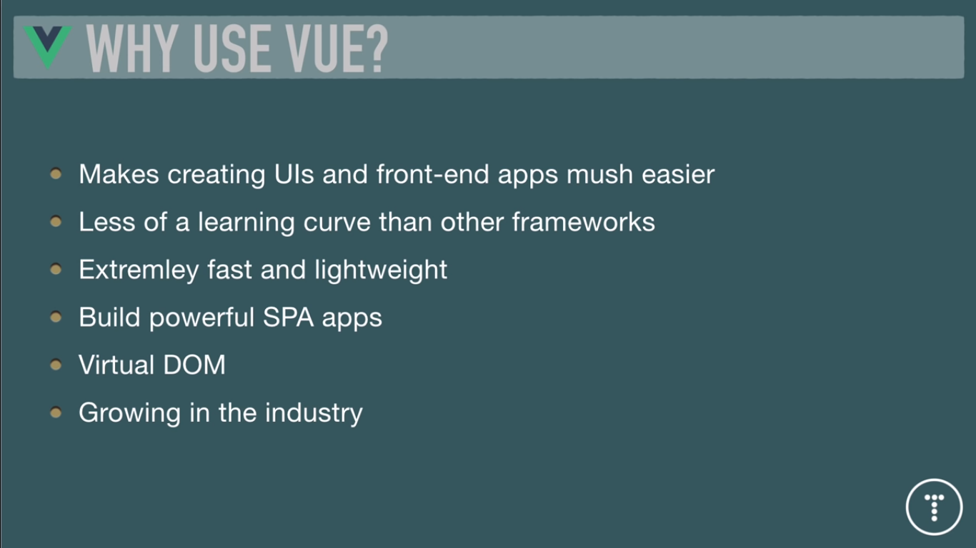
Why Vue JS
D.S.R.Murthy

Slide 8
Vue 3 features
- Lots of internal API changes compared to Vue.js 2.0 which supports only optional API. Vue 3.0 supports teleport, suspense and multiple root elements to load multiple vue instances.
- Smaller bundle size: Vue.js 3.0 is more optimized for performance and comes with a smaller bundle size than Vue.js 2.0.
-Composition API: Vue.js 3.0 has Composition API that makes it easier to manage complex state and logic in components with reusable component driven programming. This API allows to use reactive data and lifecycle methods outside of components, making it easier to share code between components and testability. So avoid mixins.
D.S.R.Murthy

Slide 9
Vue 3 features
- Typescript support and good organisation of code with reusable code.
- Faster rendering: Vue.js 3.0 has updated reactivity system that improves performance and makes it faster to render components.
- Improved TypeScript support: Vue.js 3.0 has improved support for TypeScript and makes it easier to use TypeScript with Vue.js.
- Changes to the v-model directive: The v-model directive has been updated in Vue.js 3.0 to support multiple bindings and modifiers with tracking feature.
- Vue-router 4.x has drastic changes compatible with vue 3.0
D.S.R.Murthy

Slide 10
Angular vs React vs Vue
Who’s working on those Frameworks?: Angular is developed by Google, React by Facebook, Vue is a community-driven open-source project.
Philosophies : Three component-focused frameworks, where Angular has a lot of built-in features, Vue has some built-in features, React is very minimalistic.
Syntax : Angular uses TypeScript and splits HTML + TypeScript logic apart, React uses JavaScript and a feature called “JSX” (it combines “HTML” and JavaScript logic), Vue uses regular JavaScript and splits HTML + JavaScript logic apart. Also now Typescript.
Ease of Learning : Vue is easiest to learn, React and Angular are on the same level and a bit more difficult than Vue.
Performance : All three frameworks offer great startup and runtime performance, hence “performance” will not be your main decision factor.
Adoption & Popularity : All three frameworks are popular but React is a bit more popular than Angular, which in turn is getting used more than Vue.
Framework Evolution : All frameworks are under active development, new features are being added over time to all three of them.
D.S.R.Murthy

Slide 11
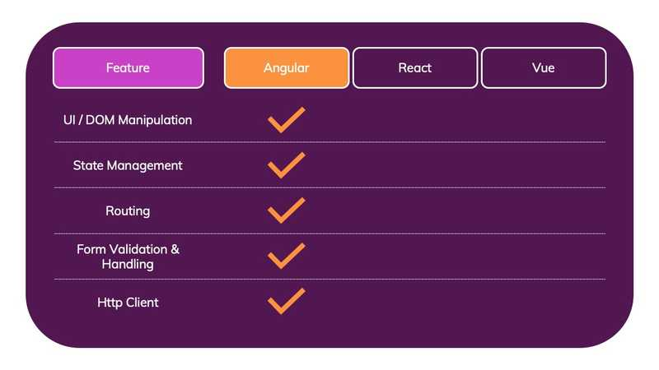
Angualar Features
D.S.R.Murthy

Slide 12
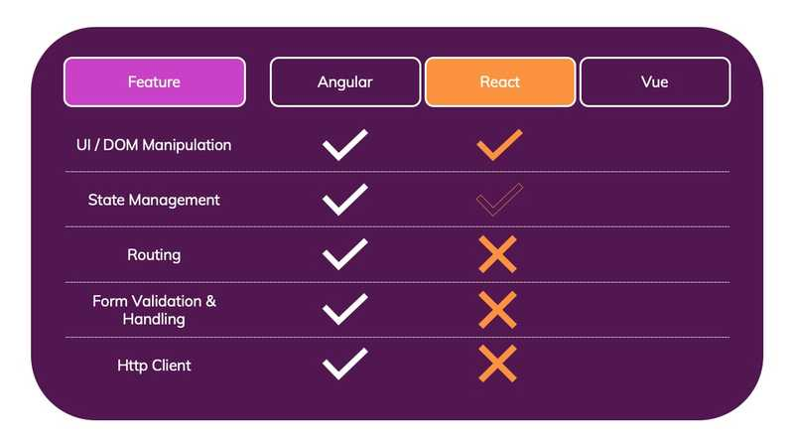
React Features
D.S.R.Murthy

Slide 13
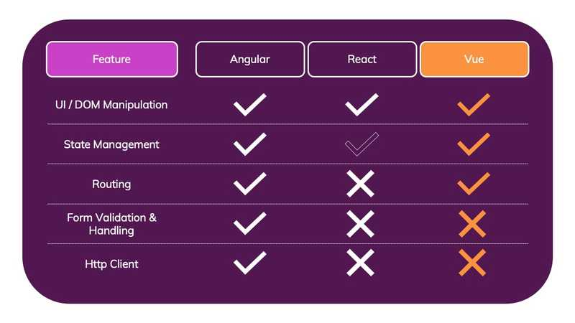
Vue Features
D.S.R.Murthy

Slide 14
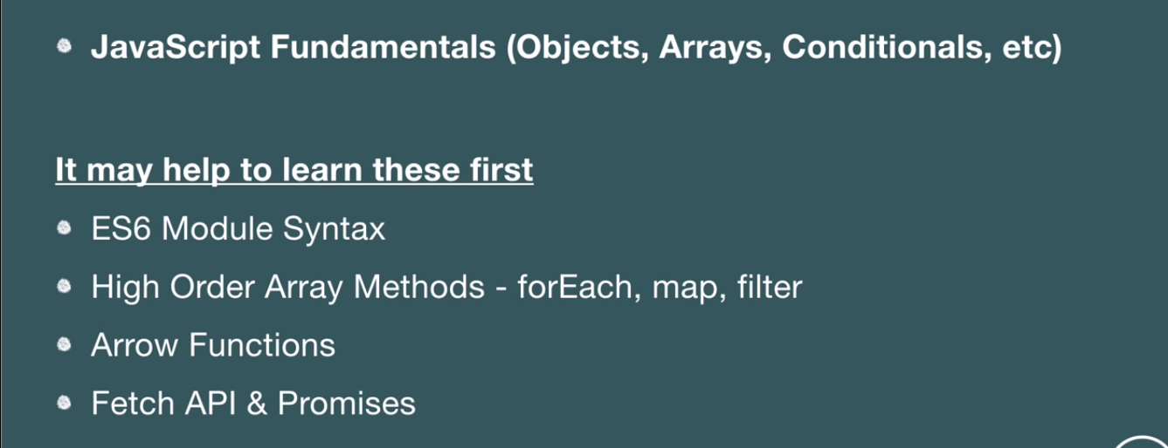
Pre-requisites
D.S.R.Murthy

Slide 15
VUE JS
Started on 2018
Easy to learn than angular/react , just need common sense
Super fast and light weight4Supports CDN single file and CLI with vue-cli.
Supports CSR and SSR
D.S.R.Murthy

Slide 16
VUE JS
D.S.R.Murthy

Slide 17
MVVM in Vue
Model contains data and business logic, and View is responsible for its representation. ViewModel handles data binding, ensuring that the data changed in the Model is immediately affecting the View layer.
D.S.R.Murthy

Slide 18
MVVM in Vue
D.S.R.Murthy

Slide 19
MVVM in Vue
Watchers are being assigned to all the directives and data properties. Then, during the set method of Object.defineProperty, the Watchers are notified and, in turn, they update the corresponding DOM or data:
D.S.R.Murthy

Slide 20
Single Fie Component in Vue
<template>
<p>{{ hello }}</p>
</template>
<script src="./hello.js"></script>
<style src="./hello.css"></style>
export default {
data() {
return {
hello: 'Hello World!'}
}
}
<template>
<p>{{ hello }}</p>
</template>
<script>
export default {
data() {
return { hello: 'Hello World!'}
}
}
</script>
<style scoped>
p { color: blue; }
</style>
D.S.R.Murthy

Slide 21
New Features of Vue 3.0
Composition API for readability and maintainability
Full TypeScript support (Vue 3.0 written in Typescript)
Portals
Fragments
Suspense
Global Mounting/Configuration API change
Multiple v-models
Custom Directive API
D.S.R.Murthy

Slide 22
Composition API
<script>
import { ref } from "@vue/composition-api"
export default {
setup () {
const theNumber = ref(1)
function doubleTheNumber () {
theNumber.value = parseInt(theNumber.value) * 2
}
return {
theNumber,
doubleTheNumber
}
}
}
</script>
Instead of writing data, methods, filters, watchers ,templates.. in one file which makes cluttered code- use Composition API
D.S.R.Murthy

Slide 23
Portals in Vue 3
<!DOCTYPE html>
<html lang="en">
<head>
</head>
<body>
<noscript>
<strong>We're sorry but this app doesn't work properly without JavaScript enabled. Please enable it to continue.</strong>
</noscript>
<div id="app"></div>
<div id="modal"></div>
<!-- built files will be auto injected -->
</body>
</html>
D.S.R.Murthy

Slide 24
Portals in Vue 3
Next, whenever we want to teleport a component, or part of a component, into the “modal,” use the Portal syntax.
<template>
<Portal target="#modal">
<div>I'm rendered in the modal, honest, I will be!</div>
<Portal>
</template>
D.S.R.Murthy

Slide 25
Suspense
Suspense is a special component that renders a fallback content instead of our component until a condition is met.
We do not need v-if="!isLoading" into the root element and a v-else on the second element to render while content loads, for example, an API or other asynchronous call.
<Suspense>
<template #default>
<MyData />
</template>
<template #fallback>
<div>Loading...</div>
</template>
</Suspense>
D.S.R.Murthy

Slide 26
Suspense
How does it detect that component should be loaded ?
This comes with the Composition API and the setup method discussed earlier. If we make the setup method async, Suspense takes over and, once we return from setup, the fallback is displayed.
Below code trigger the fallback until we have completed the call to getMyData.
export default {
async setup () {
const data = await getMyData()
return { data }
}
}
D.S.R.Murthy

Slide 27
Global Mounting
Mounting Vue app has changed slightly, and in ways that improve the possibilities of what can be done: moving from a single global instance to declaring an instance and mounting it.
D.S.R.Murthy

Slide 28
Global Mounting
Old way in Vue 2.0:
import Vue from 'vue'
import App from './App.vue'
Vue.config.ignoredElements = [/^app-/]
Vue.use(/* ... */)
Vue.mixin(/* ... */)
Vue.component(/* ... */)
Vue.directive(/* ... */)
new Vue({
render: h => h(App)
}).$mount('#app')
D.S.R.Murthy

Slide 29
Global Mounting
New way in Vue 3.0:
import { createApp } from 'vue'
import App from './App.vue'
const app = createApp(App)
app.config.ignoredElements = [/^app-/]
app.use(/* ... */)
app.mixin(/* ... */)
app.component(/* ... */)
app.directive(/* ... */)
app.mount('#app')
D.S.R.Murthy

Slide 30
Multiple v-models
<NameComponent
v-model:fornames="forname"
v-model:surname="surname"
/>
D.S.R.Murthy

Slide 31
VUE JS
D.S.R.Murthy

Slide 32
VUE JS
D.S.R.Murthy

Slide 33
VUE JS

Slide 34
VUE JS
D.S.R.Murthy

Slide 35
VUE JS
D.S.R.Murthy

Slide 36
VUE JS
D.S.R.Murthy

Slide 37
VUE JS
D.S.R.Murthy

Slide 38
VUE JS
D.S.R.Murthy

Slide 39
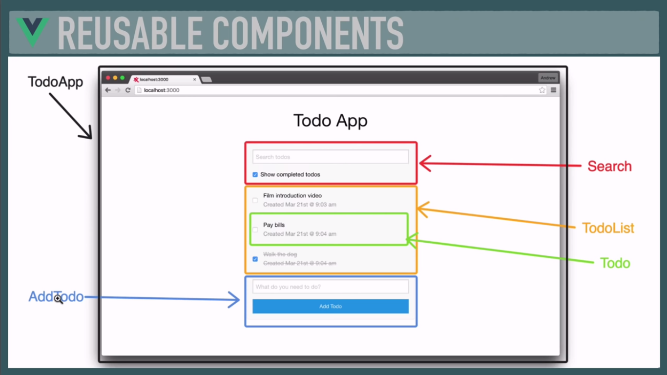
VUE JS
D.S.R.Murthy

Slide 40
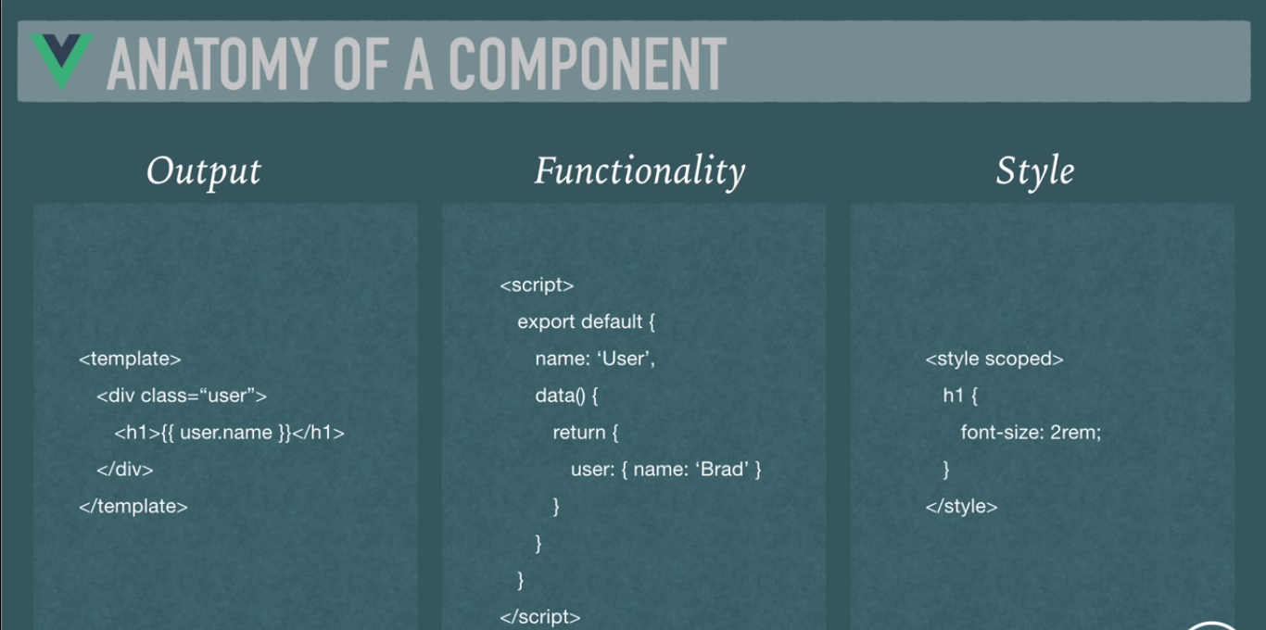
VUE JS
D.S.R.Murthy

Slide 41
VUE JS
D.S.R.Murthy

Slide 42
VUE JS
D.S.R.Murthy

Slide 43
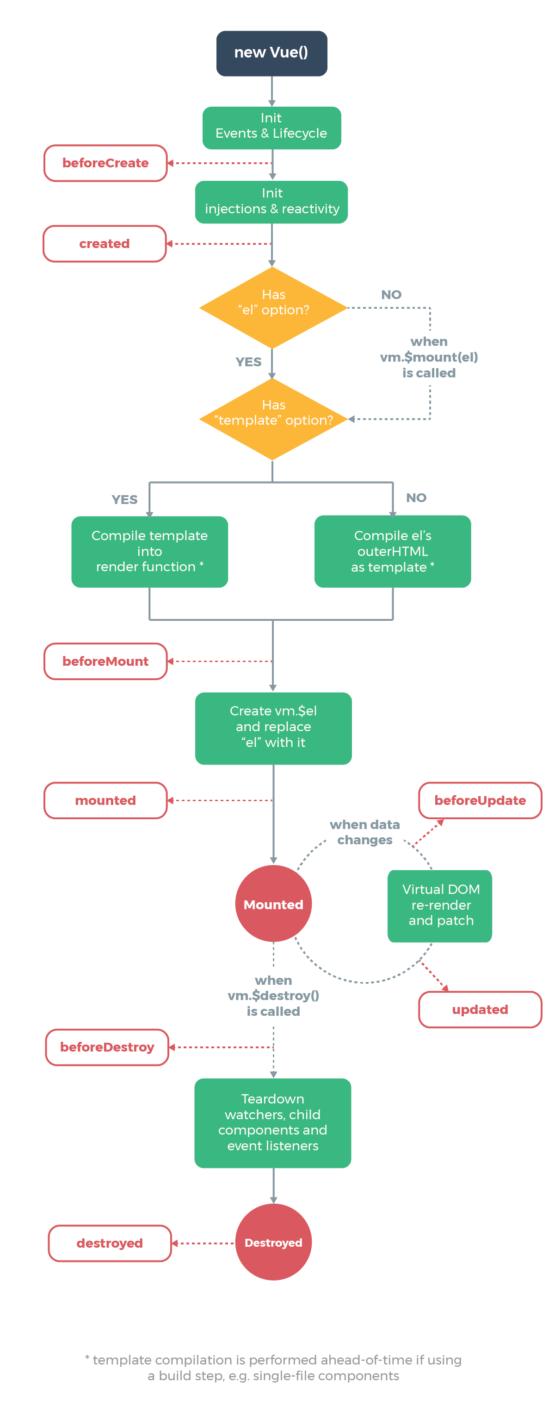
VUE Lifecycle
D.S.R.Murthy

Slide 44
Component Lifecycle hooks
beforeCreate : Here we can’t interact with any part of the component yet
created : invoked after the creation of the component instance. Interact with the component, i.e. the data properties, watchers, computed properties, but still can’t access the DOM. Fetch data from API.
beforeMount : The component is compiled at this stage, but yet to be rendered on to the screen.
mounted : This is after the component has been mounted. Now,we access the $el method and play around with the content inside HTML elements.
beforeUpdate : Whenever changes are made to data or the DOM, right before that, this lifecycle hook is called. Use to log changes.
updated : This is right after the changes are made to the DOM or the data.Perform operations dependent on the change in the DOM.
beforeDestroy invoked before the component is destroyed and is the last instance of the fully functional DOM. Perform closing operations here.
destroyed : Component is not functional here and no data properties, watchers, computed properties, events can be accessed.
D.S.R.Murthy

Slide 45
VUE JS
D.S.R.Murthy

Slide 46
VUE JS
D.S.R.Murthy

Slide 47
VUE JS
D.S.R.Murthy

Slide 48
VUE js Setup
Install Node >16.x
Vue js dev tools for chrome
Install visual Code IDE
Download vue/cli
D.S.R.Murthy

Slide 49
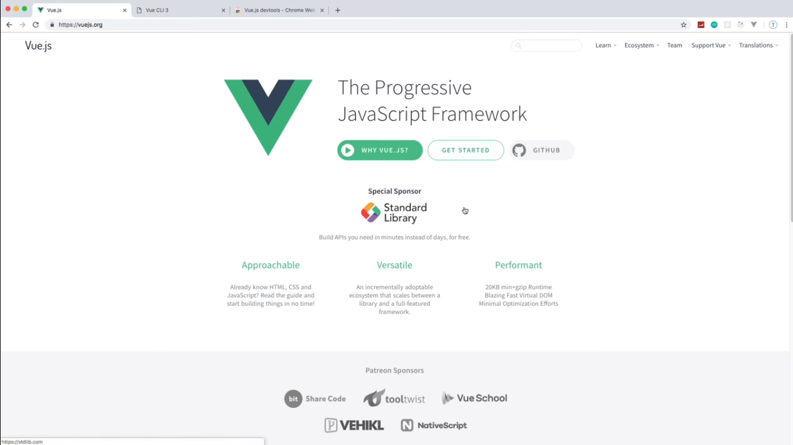
VUE js Setup
D.S.R.Murthy

Slide 50
VUE js Setup
$ npm install –g @vue/cli
$ vue - -version
$ vue create vue3-app
Preset: default (Babel)
$ cd vue3-app & npm run serve
Open browser and visit : localhost:8080
To use vue ui
$ vue ui (runs on localhost:8000)
We can create project , remove project etc from UI.
Install VS code extension : vuter
D.S.R.Murthy

Slide 51
VUEX

Slide 52
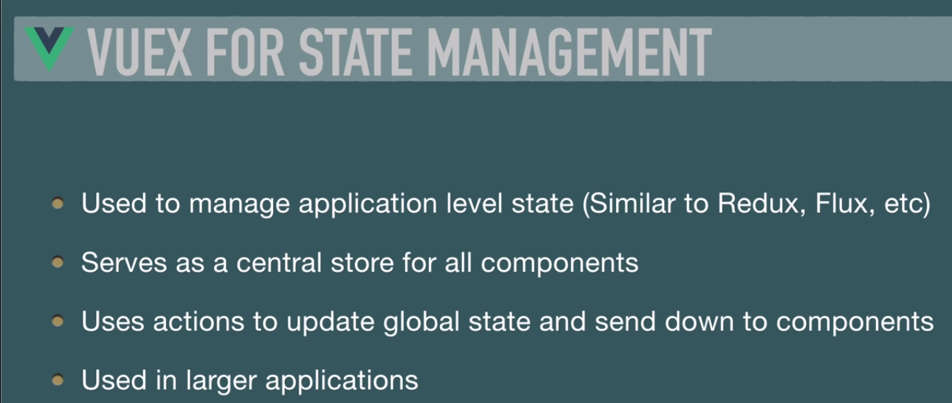
VUE JS
D.S.R.Murthy

Slide 53
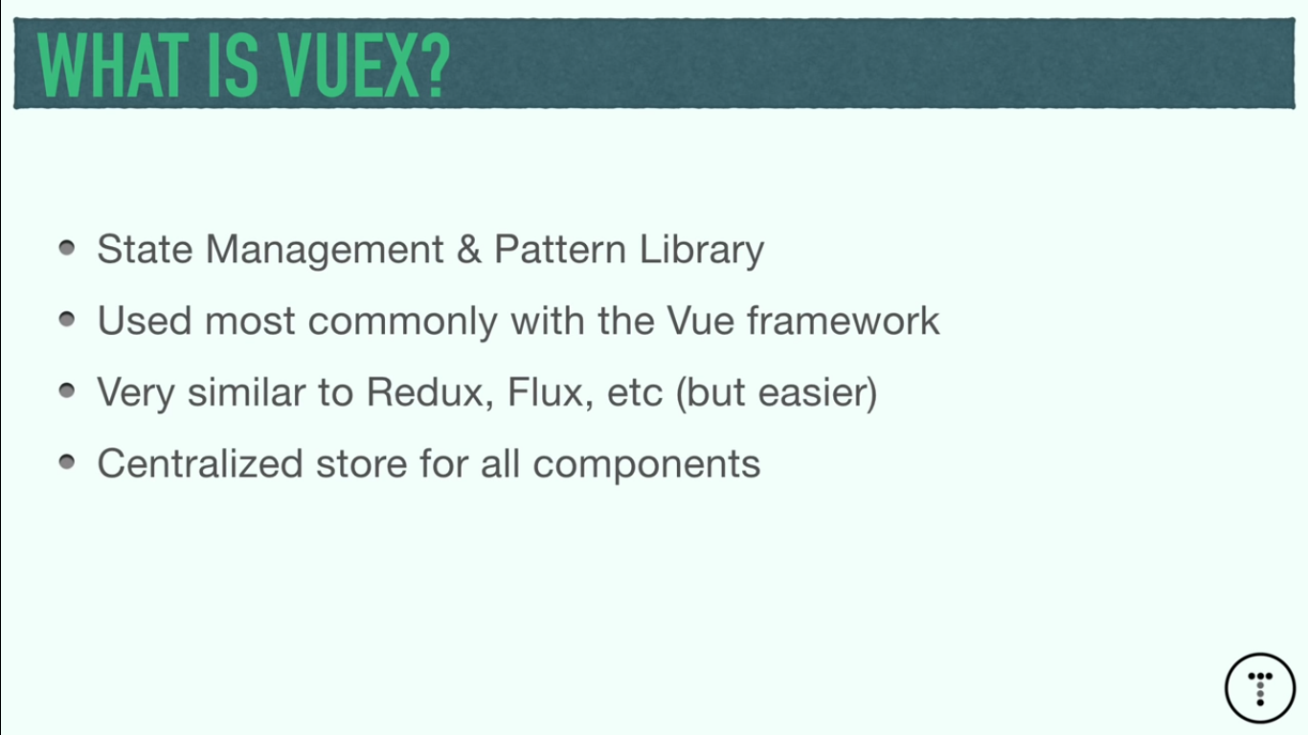
Vuex
D.S.R.Murthy

Slide 54
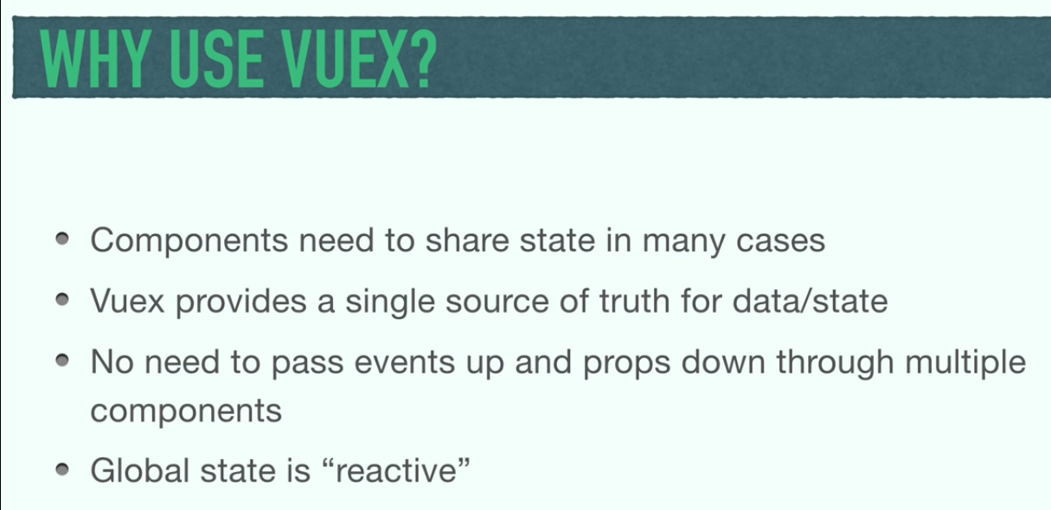
Vuex
D.S.R.Murthy

Slide 55


VueX Pattern
It is imitation of Flux/Redux pattern.
VueX is a simple, predictable state model. An emphasis on functional programming and immutable data.
With Vuex
Without Vuex

Slide 56
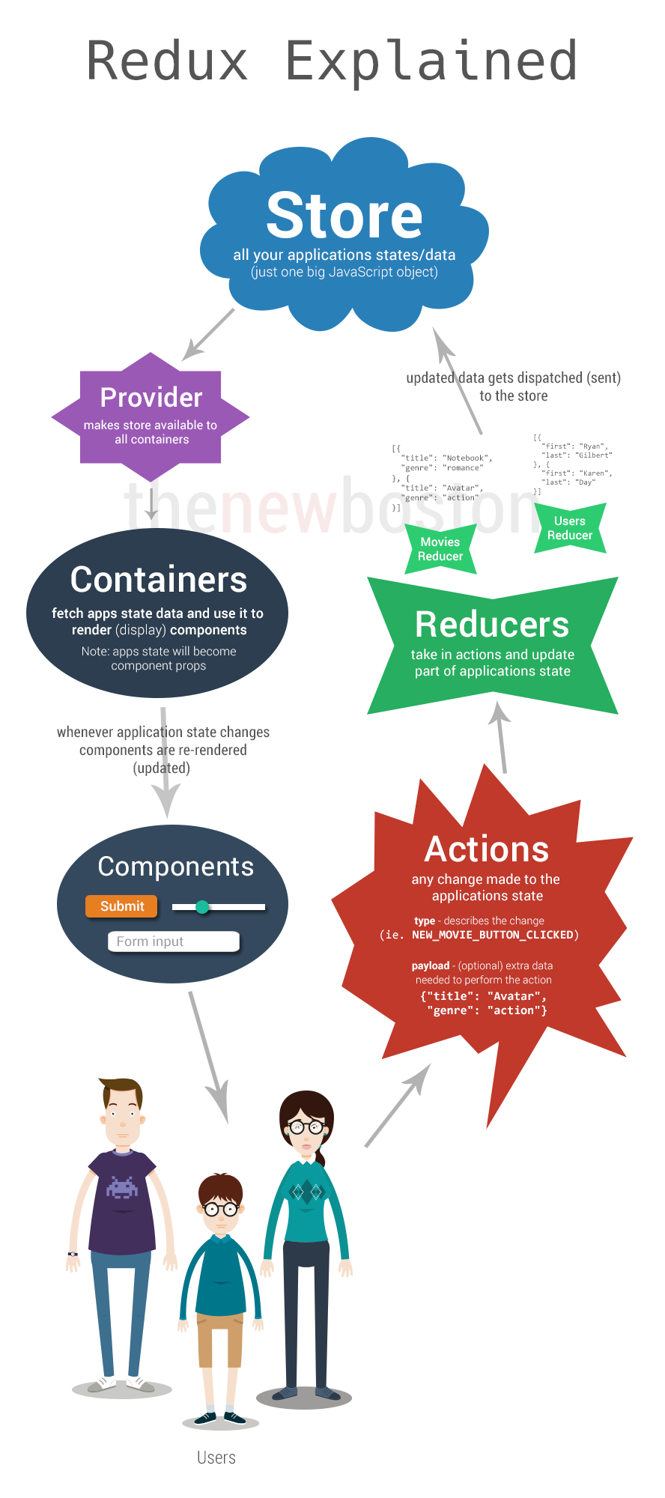

Slide 57
VUEX JS
D.S.R.Murthy

Slide 58
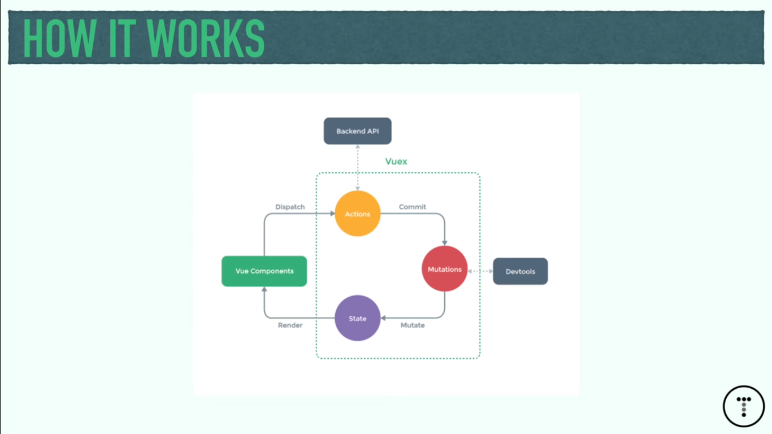
Vuex – How it Works?
D.S.R.Murthy

Slide 59
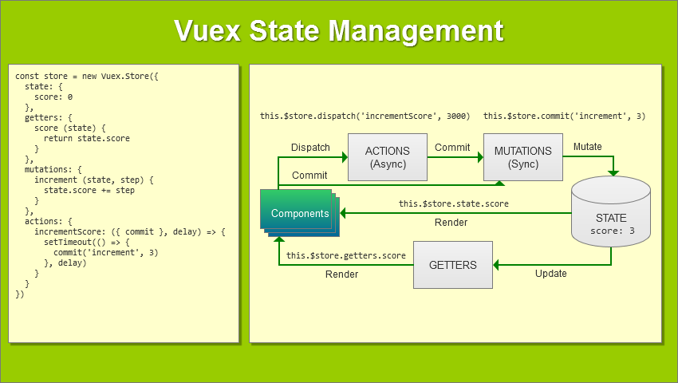
Vuex – How it Works?
D.S.R.Murthy

Slide 60
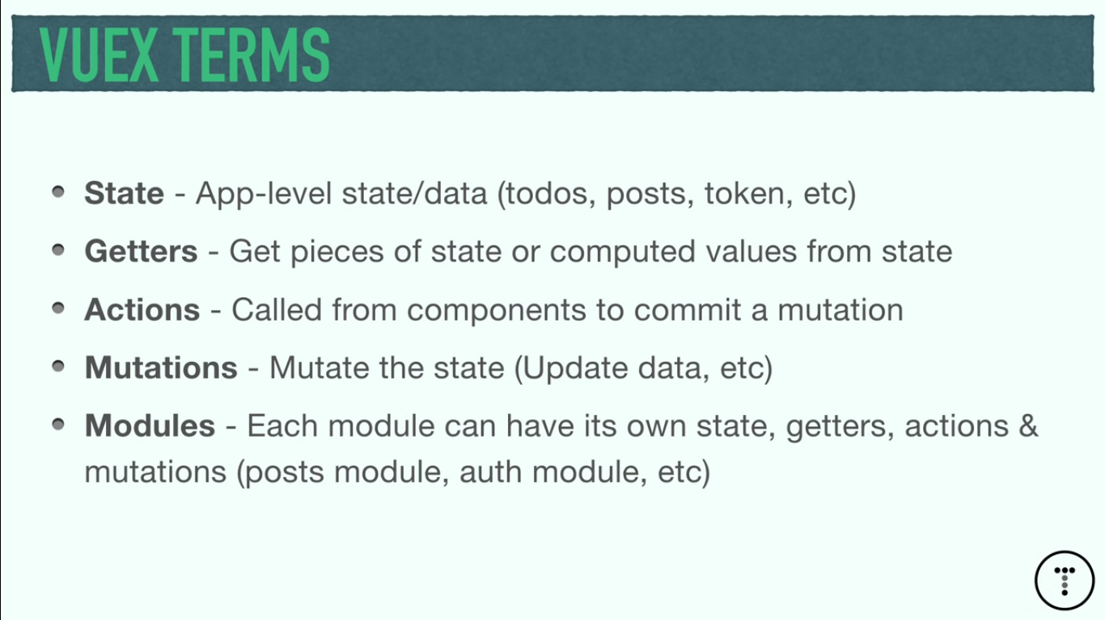
Vuex – Terms
D.S.R.Murthy

Slide 61
Vuex – setup
$ npm install vue@next
In main.js, configure:
…
import {createStore} from ‘vuex’
const app=createStore(App)
App.mount(‘#app’)
D.S.R.Murthy

Slide 62
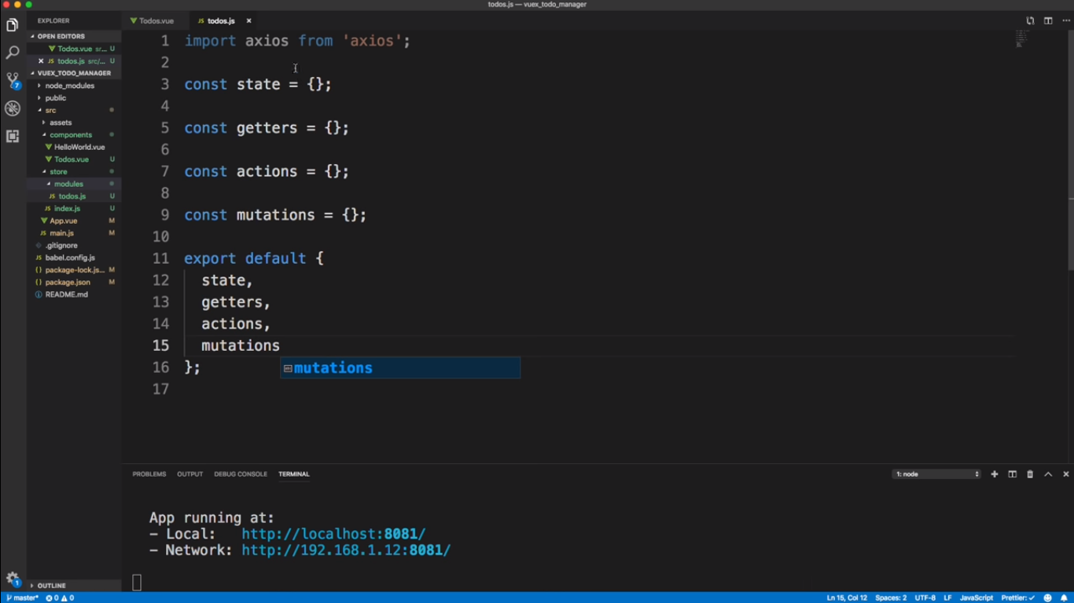
Vuex – boilerplate
D.S.R.Murthy

